Slide 1
Admission Compass
Group Partners:
Ariela Epstein 328606686
Tal Uzan 204344592

Slide 2
Navigating Higher Education
Introduction
Starting the journey of higher education can be intimidating and overwhelming.
Students deal with decisions about career paths, finding the right schools, and navigating through the diverse admission processes.
Changing Landscape
Today, universities are broadening their admission criteria to cultivate more diverse and successful student bodies.
Despite these positive changes, students may still lack awareness of alternative paths to admission.
Notes:
למה בכלל
האתגר בלהבין מה הם תנאי הקבלה והאפשריות בכל מכללה/אוניברסיטה

Slide 3
Goals
Offer support in the admission process.
Ensure access to information about available paths to admission.
Empower students with knowledge about available admission requirements.
Notes:
להנגיש את כל האפשריות הקיימות לקבלה לתואר מסויים
לאפשר לסטודנט לדעת איפה הוא עומד מבחינת הסיכויים שלו להתקבל
לתת מוטיבציה לסטונדט ביכולת שלו להתקבל

Slide 4

Objectives
Develop a User-Friendly Website
Create a website that helps users explore degree programs and their admission criteria easily.
Collect Data
Offer a platform for former students to share their admission criteria and store in database tables.
Implement a Search Tool
Incorporate a search tool that allows users to refine searches by degree, institution, and personal scores.
Visualization
Utilize built-in tools, functions, and machine learning to present and predict data.
Notes:
חווית משתמש נוחה
איסוף מידע של סטודנטים לשעבר
מנוע חיפוש

Slide 5

Metrics
Accepted Student Submissions
Track number of submissions from accepted students to gauge user engagement.
Search Queries
Monitor user search queries to identify trends in behavior, popular topics, track number of engagements, and peak search times.
User Feedback
Gather feedback through surveys and reviews to assess user satisfaction and measure overall website success.
Notes:
טפסים של סטודנטים מהעבר
איסוף מידע של החיפוש (תואר דומיננטי או מכללה)
מילוי סקרים לשיפור חווית המשתמש

Slide 6
Literature Insights
Higher education enrollment is on the rise globally, thanks to cultural values and institutional marketing efforts.
Schools are looking to expand their student body, prompting them to broaden their admission criteria.
Traditional reliance on standardized tests is being challenged, with schools recognizing alternative methods to predict academic success.
More students are applying to multiple institutions to boost their chances, but this can be costly.
The demand for guidance in college applications is growing, aiming to ease stress and aid students in navigating the new admissions journey.
Notes:
More students are applying
Schools wanna expand
Its costly
need guidance

Slide 7
Competitive Analysis
Competitor 1: (לימודים בישראל)Studies in Israel
Comprehensive resource hub for higher education in Israel.
Features a prediction tool estimating admission likelihood based on psychometric and bagruyot scores.
Strengths: Wealth of information about admission requirements, admission prediction tool, insights into user success rates.
Weaknesses: Limited data inputs, confusing layout, potential overlook of important admission factors.
Notes:
Lots of info
Prediction tool
weakness

Slide 8
Competitive Analysis
Competitor 2: "College Scoreboard“
Enables users to search for institutions and compare data.
Strengths: Clear and concise presentation, streamlined search process, visual data comparison.
Weaknesses: Limited personal data inputs and no predictive tools.
Notes:
Search tool based on
No prediction tool
weakness

Slide 9
Competitive Analysis
Competitor 3: "CollegeData.Com“
Provides detailed information and a robust college acceptance calculator.
Strengths: admission prediction tool and provides multiple admission requirement inputs.
Weaknesses: Overwhelming amount of information, unclear visualization, required account creation.
Notes:
Prediction tool
Overwhelming

Slide 10
Competitor-Informed Website Strategy
Focus on admission requirements for Israeli institutions.
Collect thorough admission data from past and current students.
A user-friendly search tool with filter capabilities that provides clear visually appealing admissions insights.
Integrate an admissions prediction tool that includes multiple admission criteria as inputs.
Notes:
Israeli schools
Prediction tool
Search tool
User friendly

Slide 11
Functionality Requirements
Accepted Students Form
A detailed form to collect admission criteria from accepted students.
Verifies accepted students by email address domain and generates a random code sent to the student email for further validation.
Data is stored in a structured table in the database.
Submission Tracking
Use this data from accepted students.
Evaluate influxes of user engagement.
Our goal - enhance user engagement and optimize business operations.
Notes:
מסמך עבור סטודנטים לשעבר שיוכלו להעלות את האופן בוא הם התקבלו

Slide 12
Functionality Requirement
Search Tool
A search tool that allows users to explore admission requirements
Make searches based on degree, institution, or personal grades..
Each search is stored in a table in our database.
Search Behavior Analysis
Analyze past searches, such as date searched, filters used, degrees searched.
Evaluate popular searches
Provide insights into how to better our search functionality and user experience.

Slide 13
Functionality Requirements
Search Results
Search tool queries the database tables.
Searches are done by built-in SQL functions, advanced coding techniques, and machine learning methodologies.
Results are presented in a list format.
Search filters are included to refine information retrieved.

Slide 14
Functionality Requirements
Selected Search Result
Presents comprehensive details regarding the institution and/or degree selected.
Provides insights into admission requirements.
Utilizes SQL functions such as AVG(), MIN(), and MAX() to analyze scores and generate averages, ranges, and distributions.
Presents the probability of acceptance to an institution and/or degree.
Highlights key factors considered in the admission process for each institution and/or degree.

Slide 15
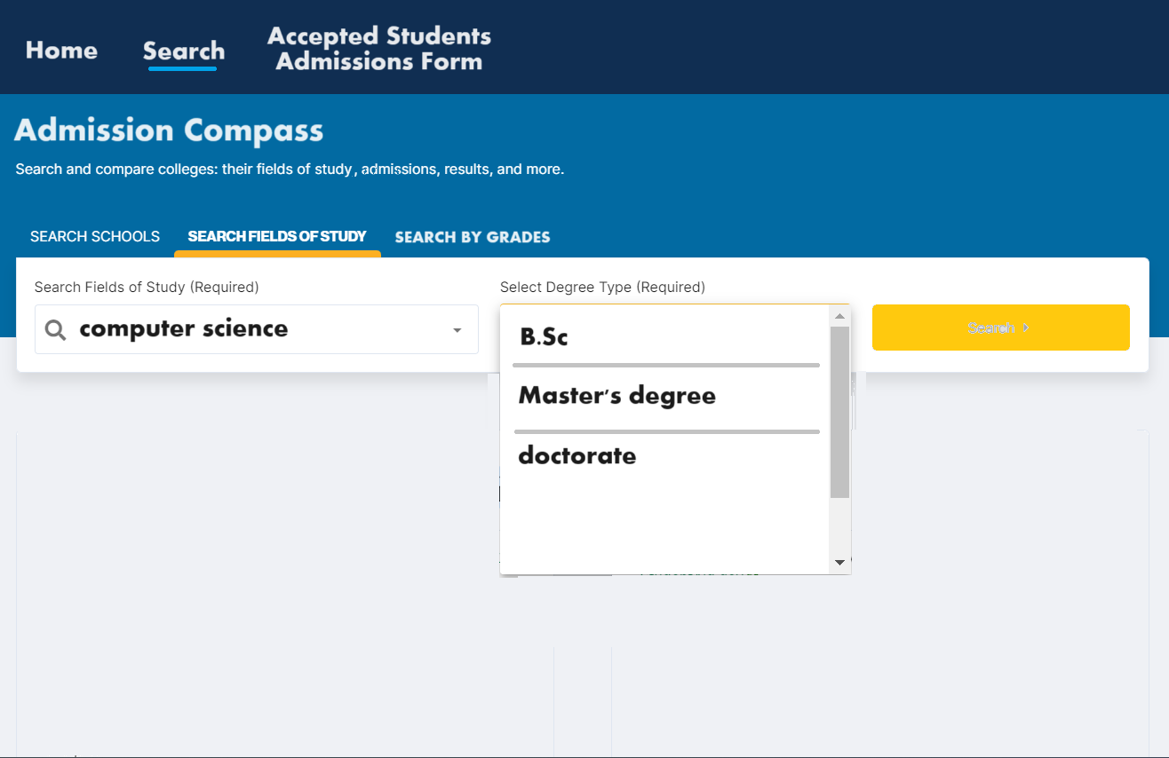
Search by Degree / Institution
Accepted
Students Form

Slide 16
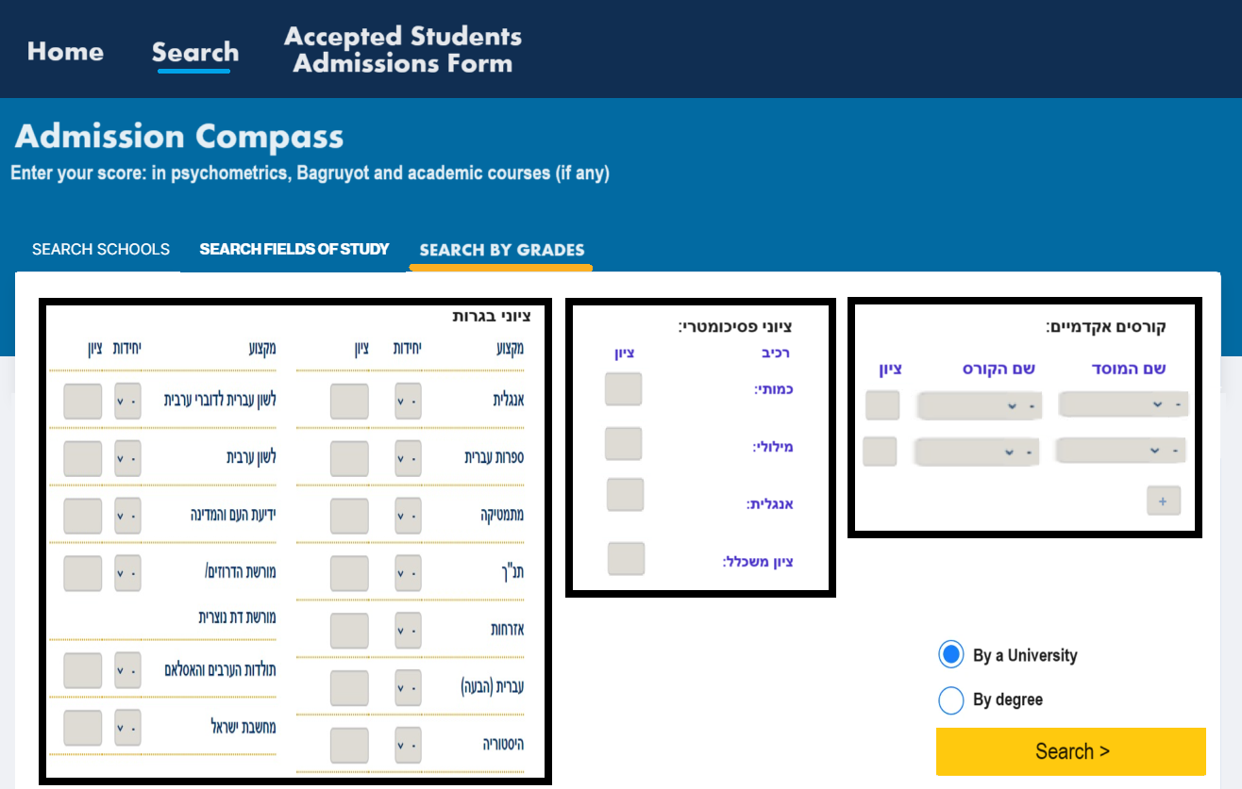
Search by grade
Accepted
Students Form

Slide 17
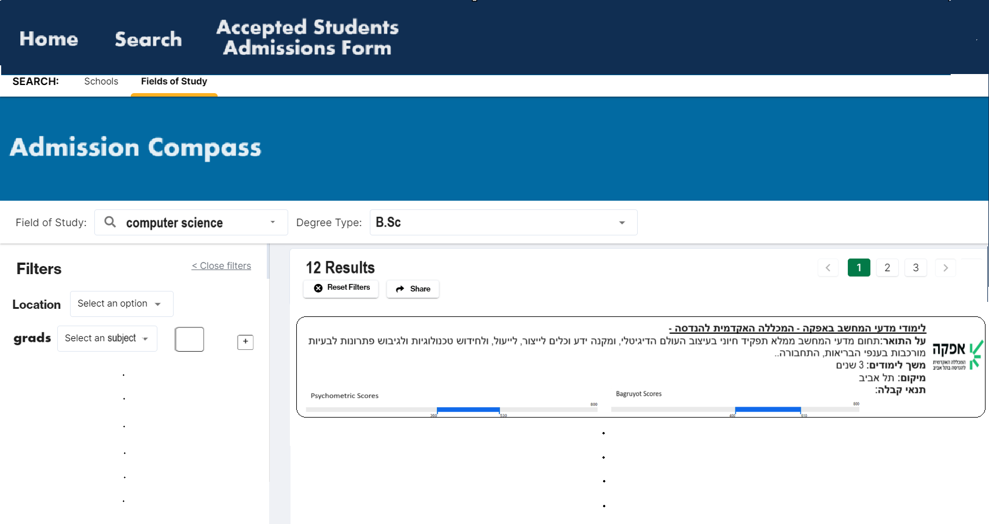
Search Results By Degree / Institution
Accepted
Students Form

Slide 18
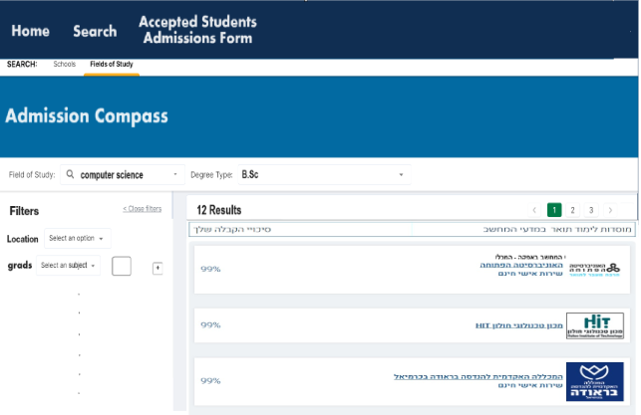
Search Results By Grades
Accepted
Students Form

Slide 19
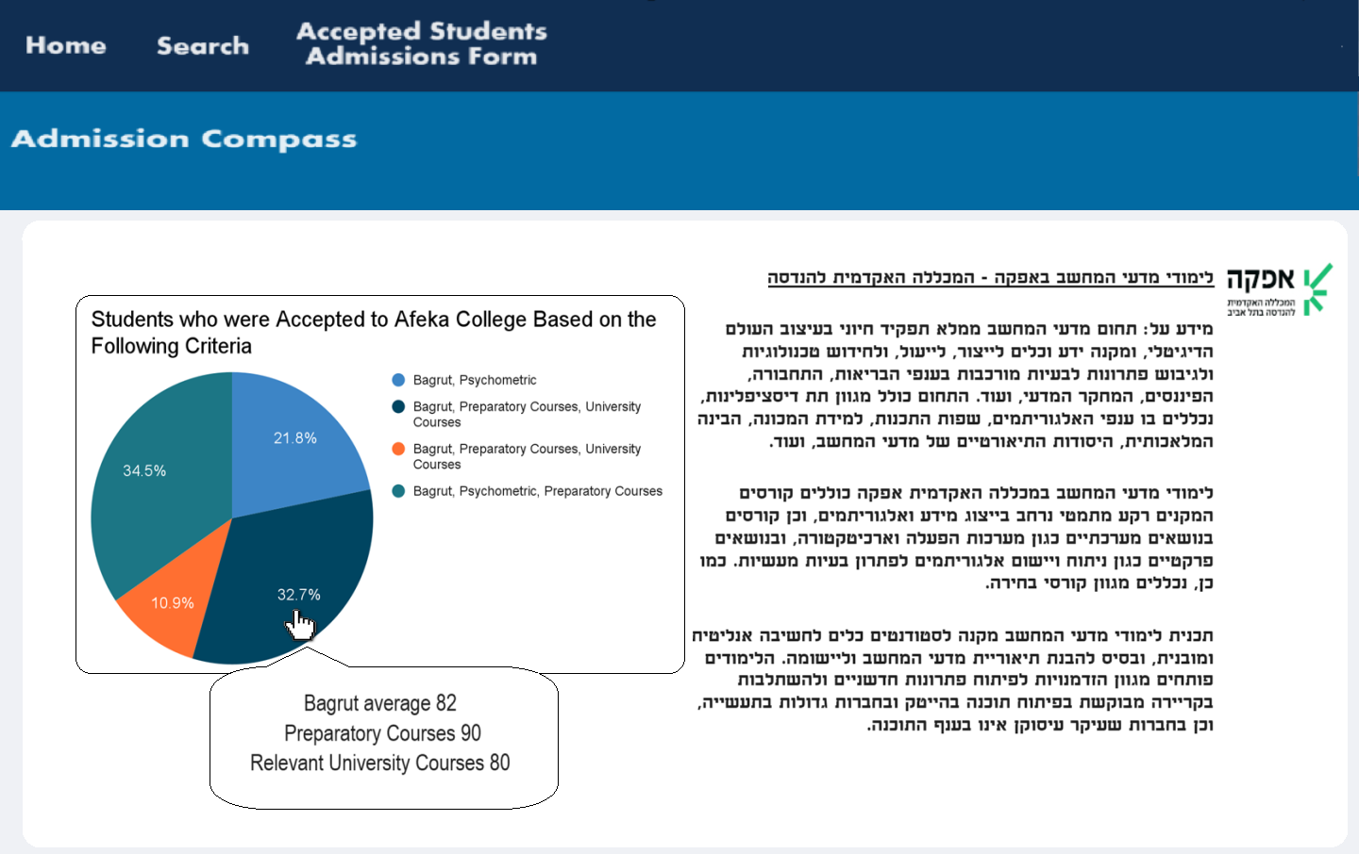
Selected Search Result By Degree / Institution
Accepted
Students Form

Slide 20
Non-Functionality Requirements
User Experience
Interface is user friendly.
Straightforward navigation and clear instructions.
Minimal but visually pleasing design.
General and detailed information (depending on user needs).
Maintainability
Clean, organized, and well-commented code.
Continuous testing and monitoring for high performance.
Efficient database management: query optimization, data integrity, and regular backups.
Website updates and feature additions.

Slide 21
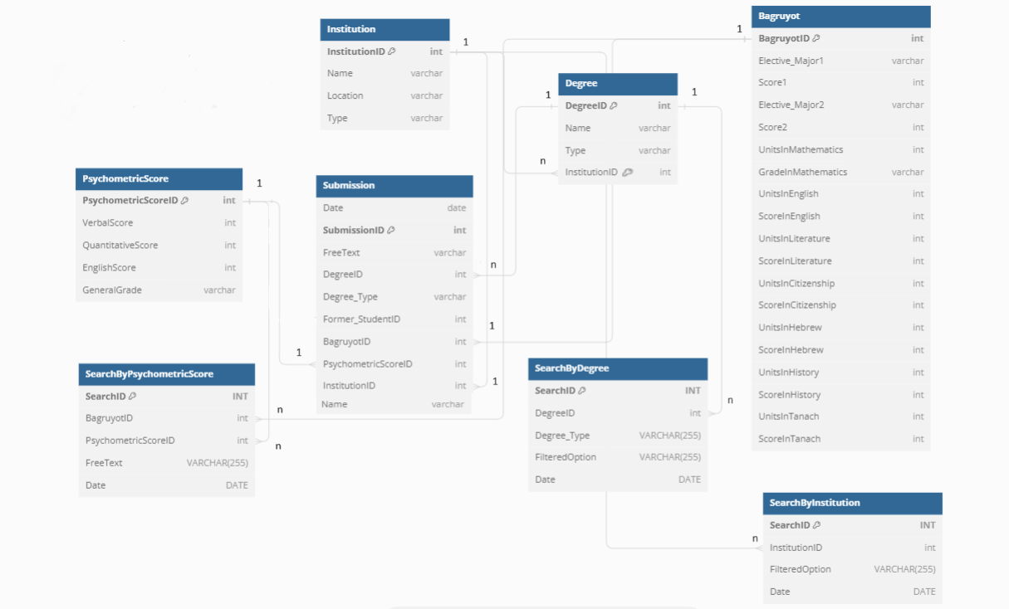
ERD

Slide 22
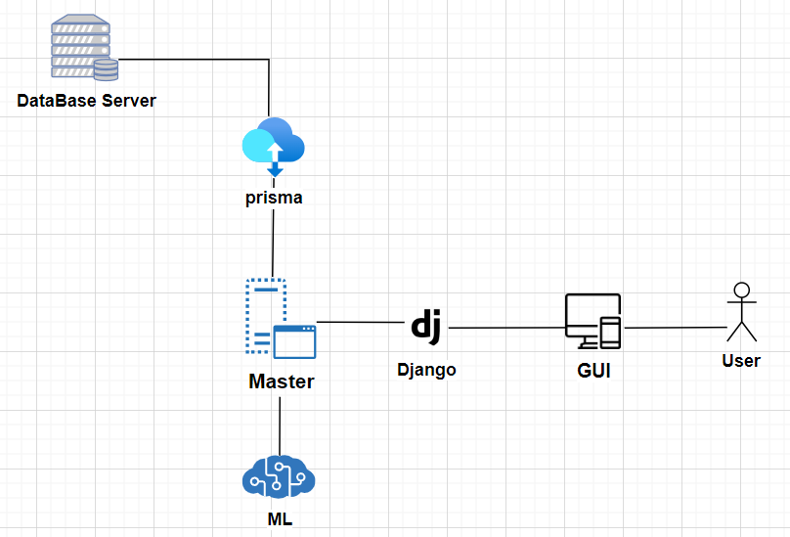
Architecture

Slide 23
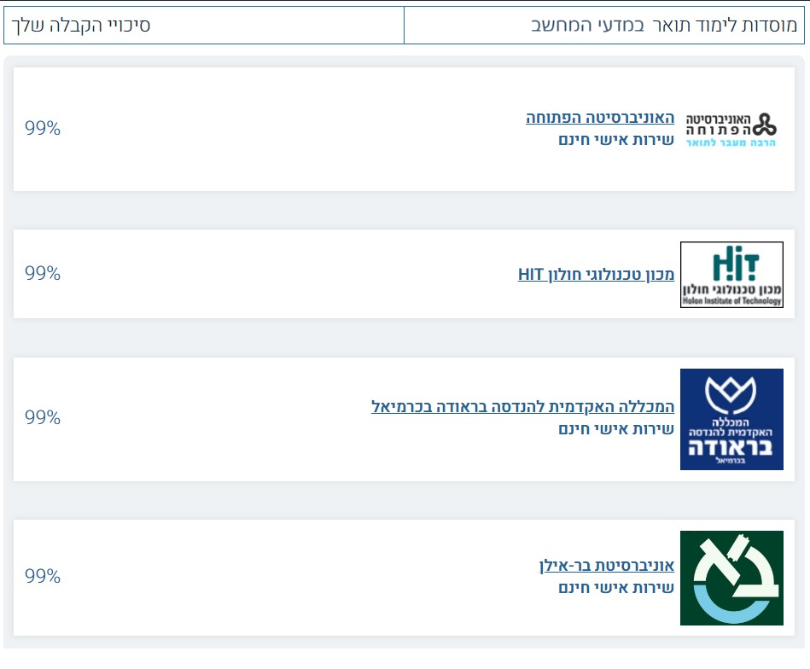
Algorithms
Acceptance Prediction Algorithm -
This gives potential students an estimation for admission success.
Analyze accepted student data and preprocess it.
Use machine learning techniques such as cosine similarity, clustering, linear regression, lasso regression, and decision trees.
Use trained models to predict new students’ acceptances.
Calculate a weighted average of the predictions to generate an overall prediction score.

Slide 24
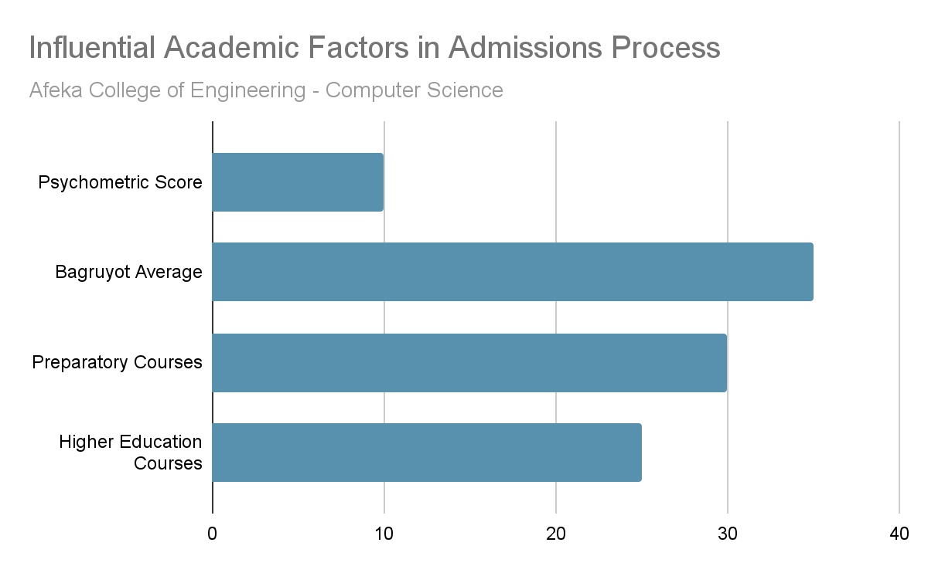
Algorithms
Academic Features Explainability
Provide students with a detailed breakdown of the most influential admission criteria for each school and degree.
Use the trained models from previous algorithm to derive most important features, using feature selection such as SHAP.
Combine SHAP results from each model, using voting algorithm.
Resulting list will help prospective students understand the important acceptance criteria for each school/degree.

Slide 25
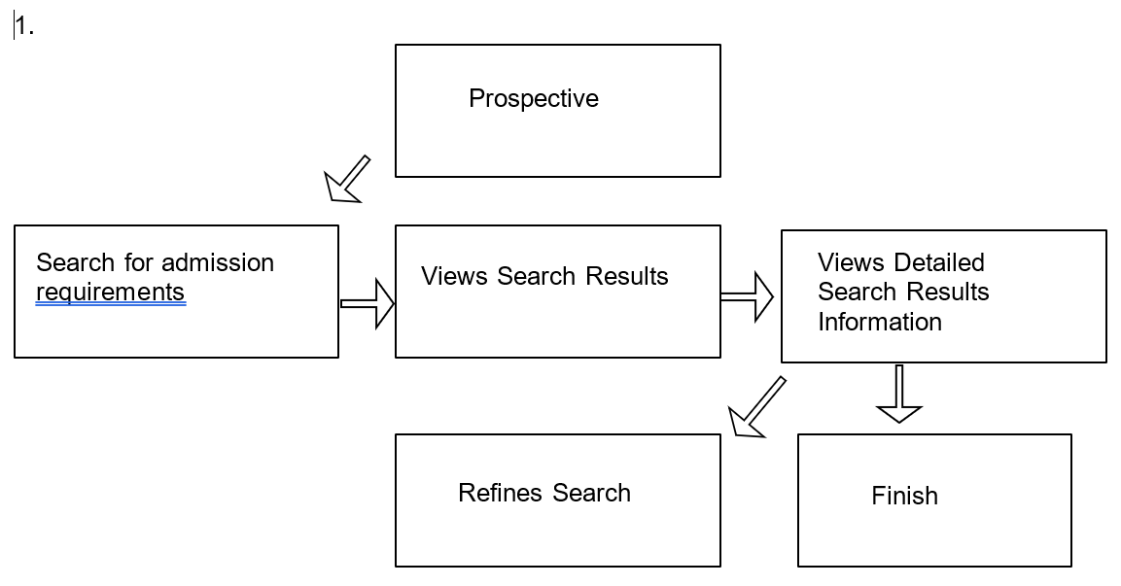
UML Diagrams of Use Cases
1.
Student

Slide 26
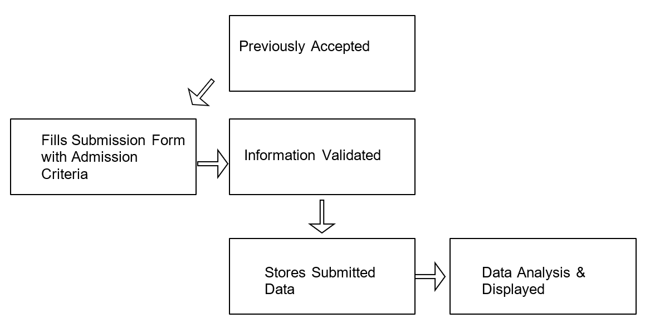
UML Diagrams of Use Cases
2.
Student

Slide 27
Optional Technologies Frontend – Javascript (React.js / Angular / Vue.js), HTML, CSS Backend – Django/Flask (Python) Machine Learning Component – TensorFlow/ PyTorch/ Scikit-Learn (Python) Database Server – PostgreSQL/MySQL/MongoDB, with SQL/MongoDB Query Language, Prisma

Slide 28
END

